Slide 2
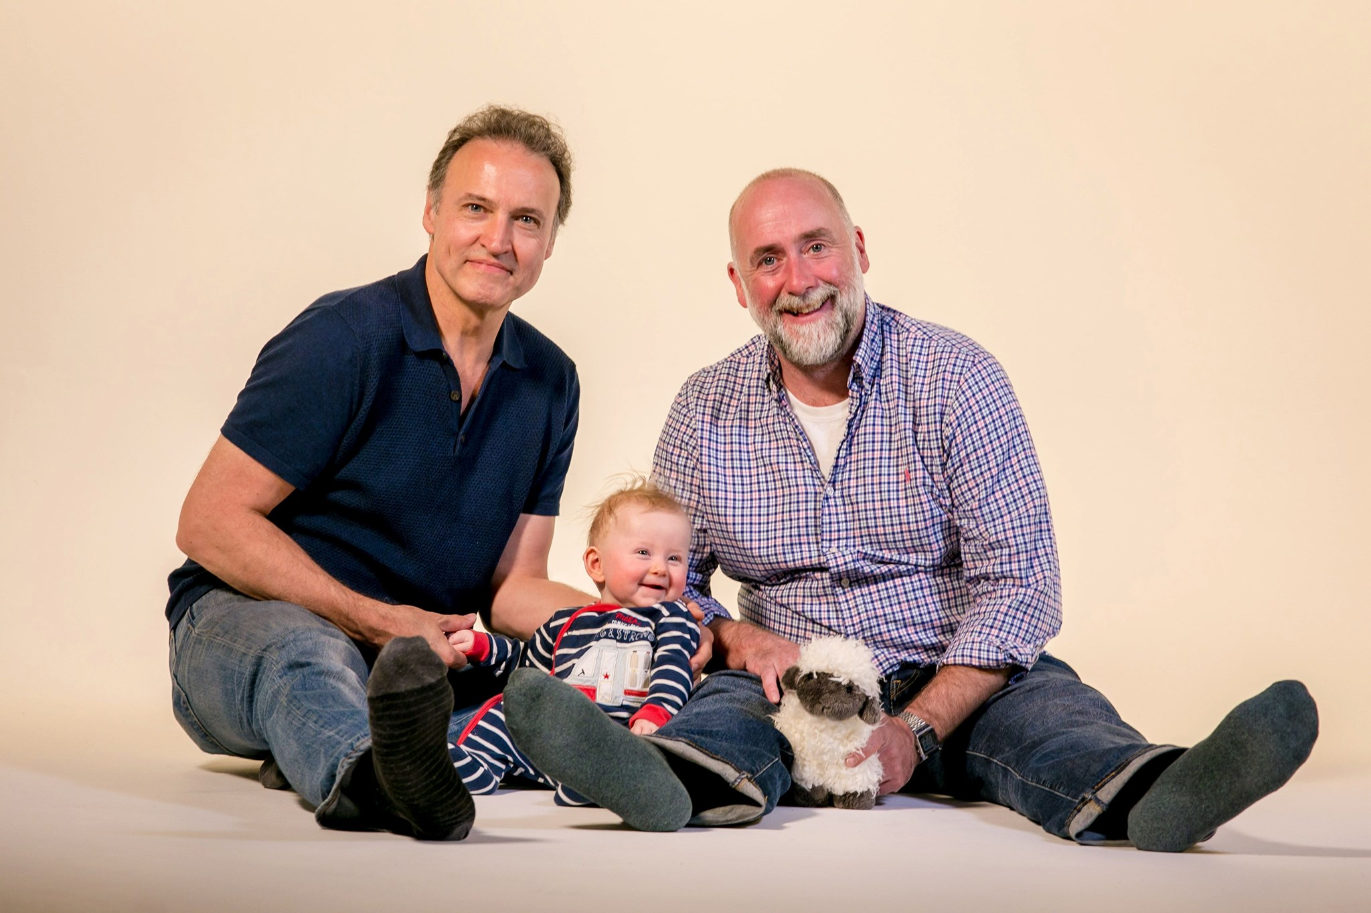

Slide 4
Daisy Badger
Primrose Fox
Tulip Hare

Slide 5
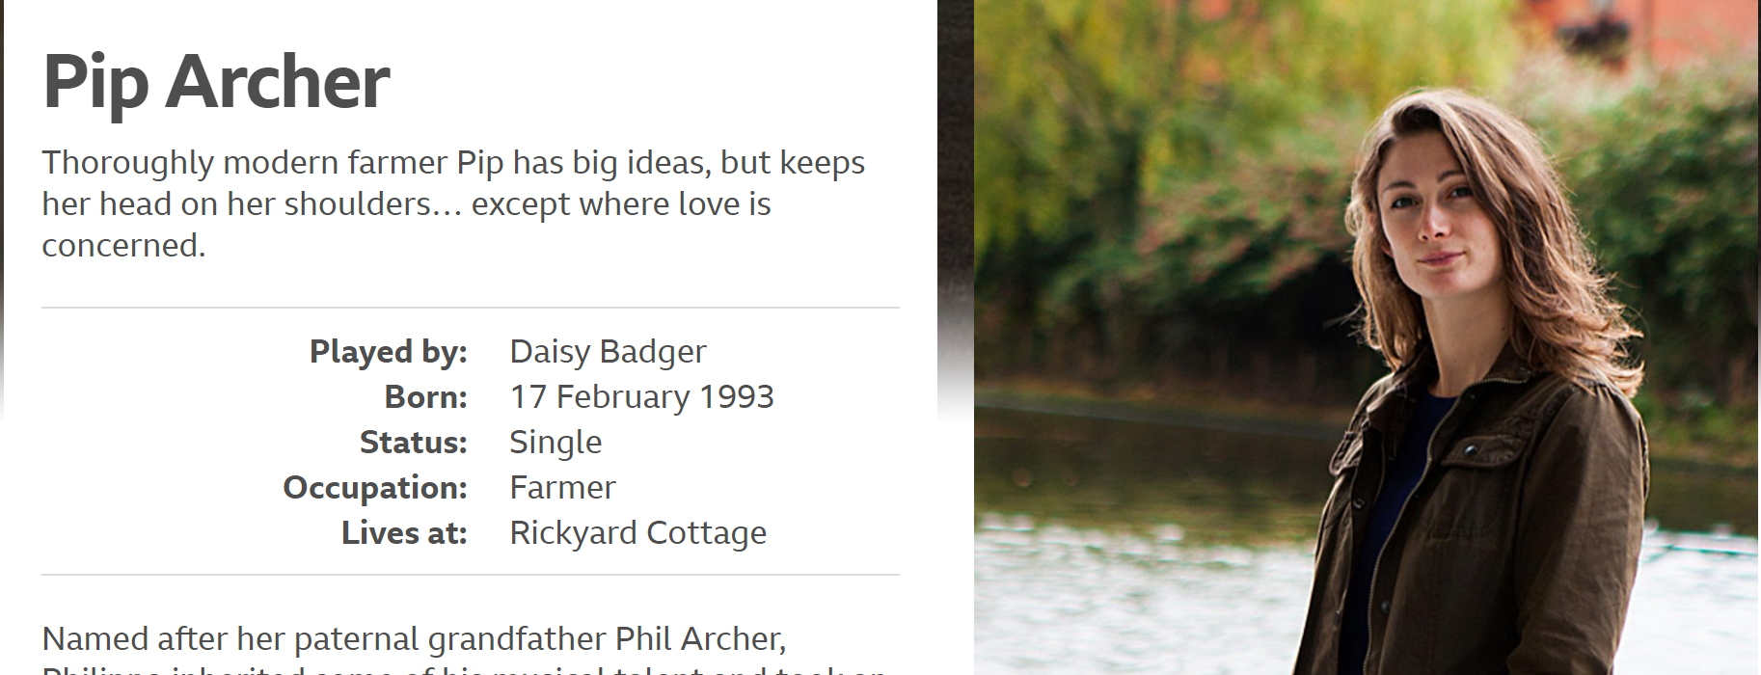

Slide 6
