Slide 1
Listen…
Notes:
Play Rock This Town, Stray Cats. This is the theme from which programme, first broadcast in 2009.

Slide 2
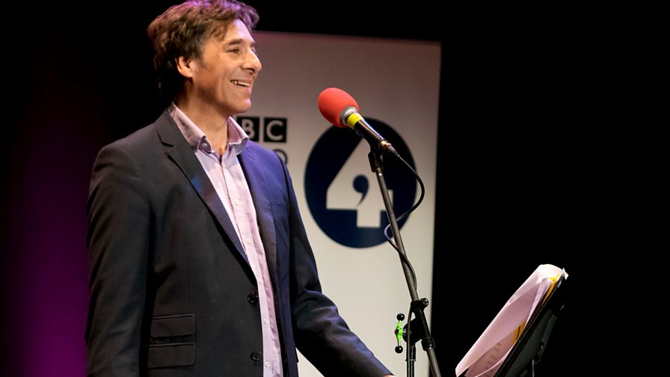
Notes:
Mark Steel

Slide 3
Listen…
Notes:
Easy one – what’s this the theme from? (DID)

Slide 4
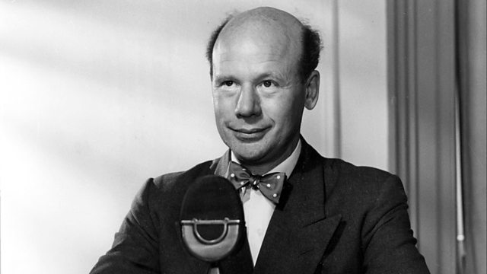
Notes:
Roy Plomley

Slide 5
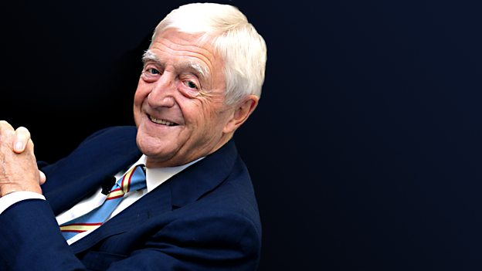
Notes:
Ry Plomley was succeeded as DID presenter by Michael Parkinson in 1985

Slide 6
Alan Ivimey
Notes:
Was the first presenter of what in 1946?

Slide 7
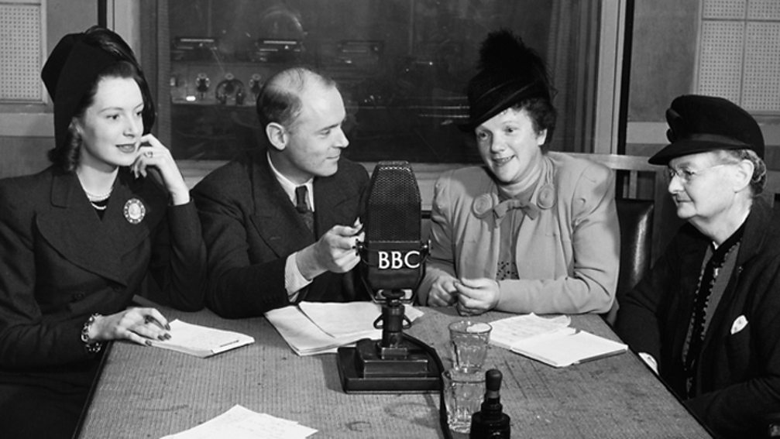
Notes:
The original presenter of Woman’s Hour, Alan Ivimey and guests

Slide 8
30 September 1967 06:35
Notes:
Was the first presenter of what in 1946?

Slide 9


