Slide 1

Audible Slides & Visual Punctuation
(Because people don’t like reading)

Slide 2
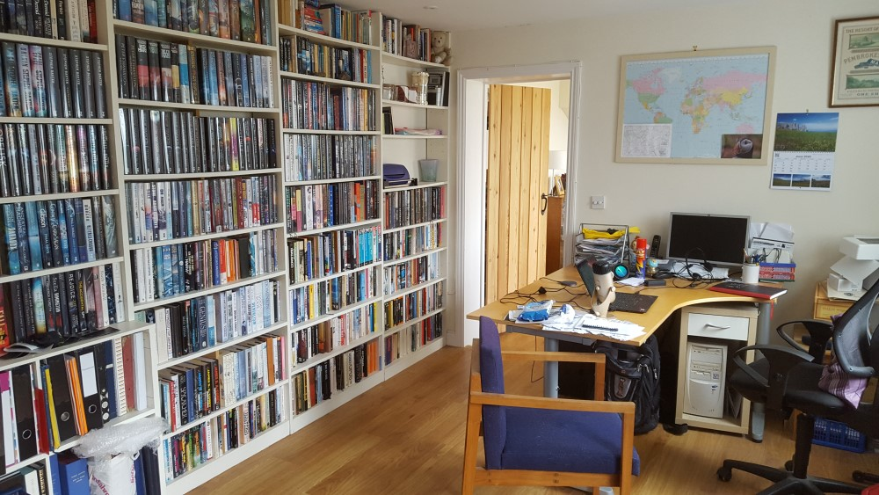
16/27
16/16
2/8
12/20
29/33
19/20
17/19
17/21
20/20
69% read
20/22
10/23
23/26
13/21
13/19
14/22
3/10
18/30
21/30
8/25
15/20
12/28
14/19
4/11
15/25
9/20
10/20
10/13
15/27

Slide 3
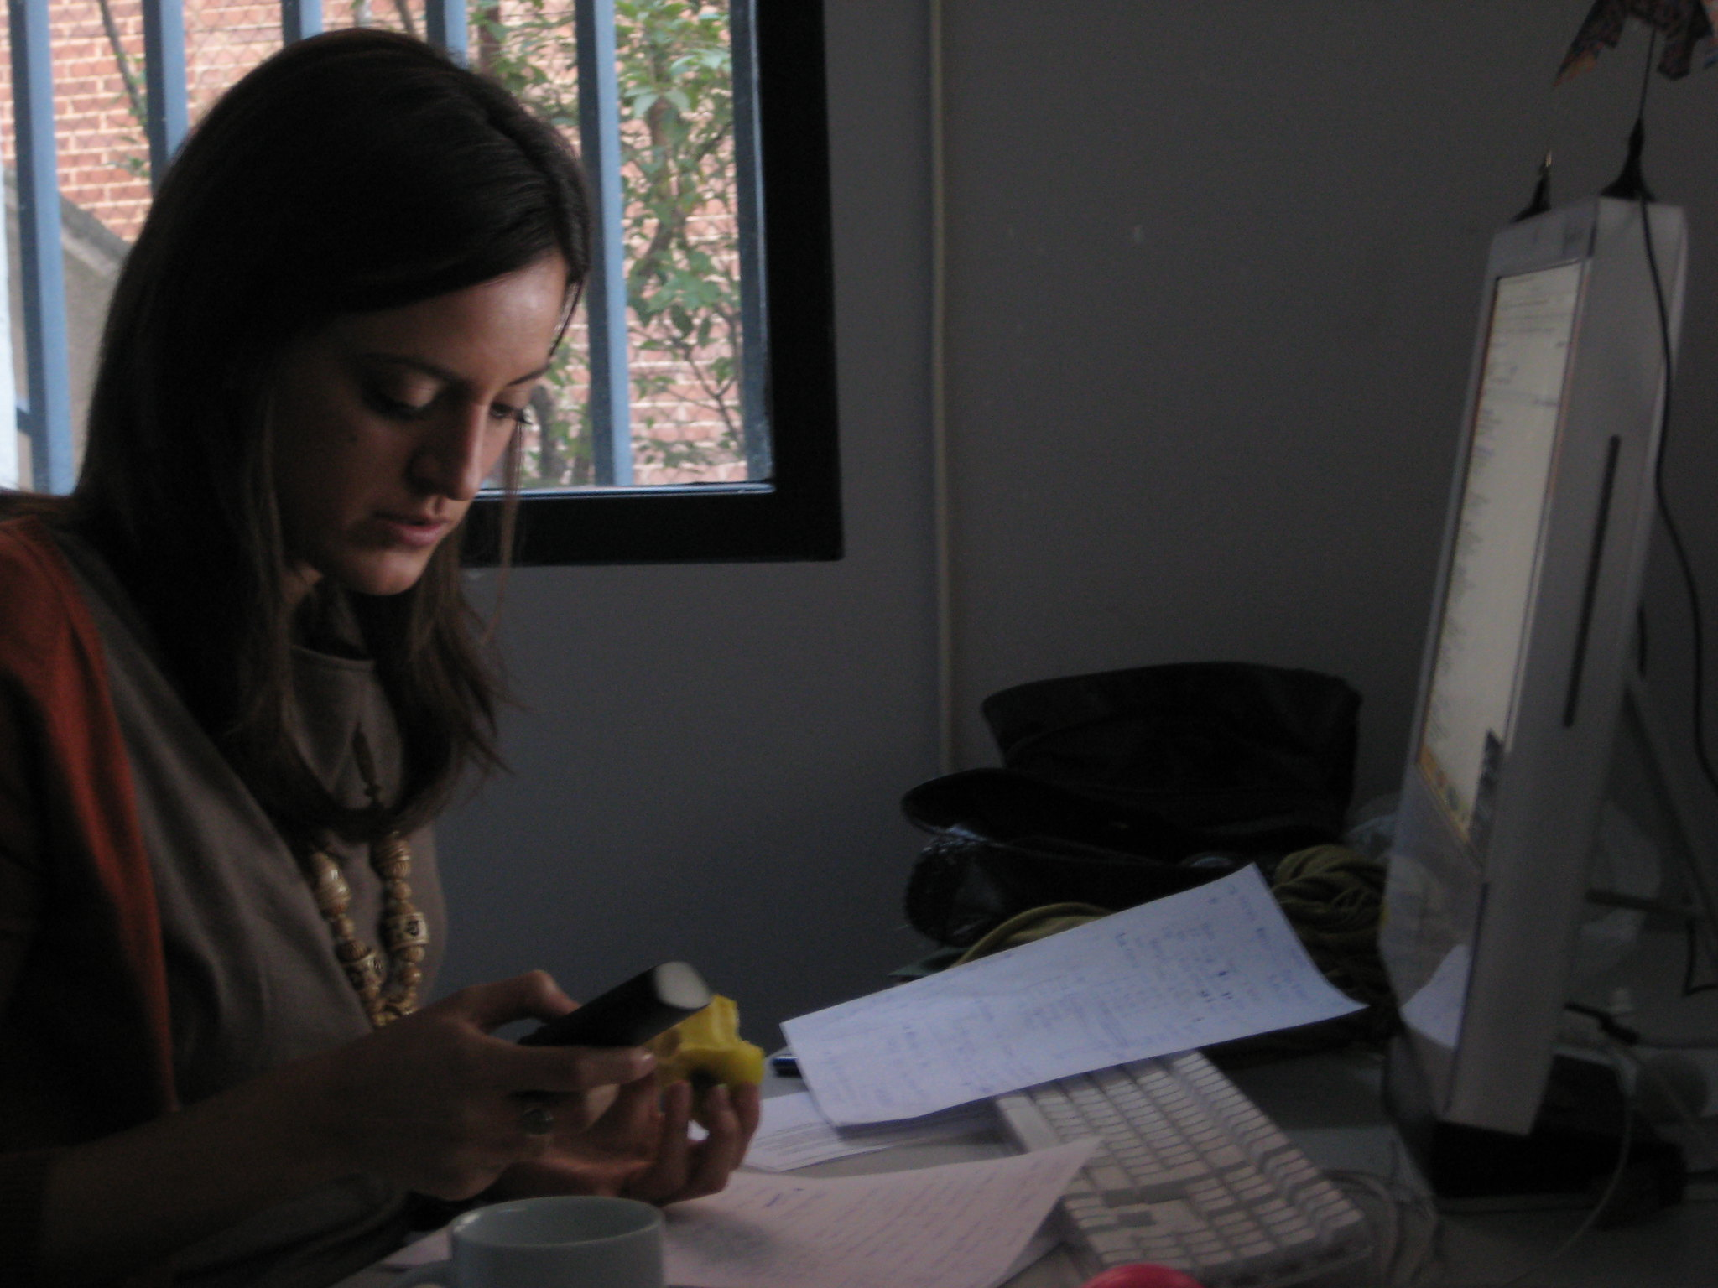
We’re talking about
Meeting pre-reads
Issues for discussion
Explaining slide decks for others
This great idea I’ve had
Something I really want to tell you
Hard working lady 1 by Roger Casas-Alatriste cc-by-nd

Slide 4
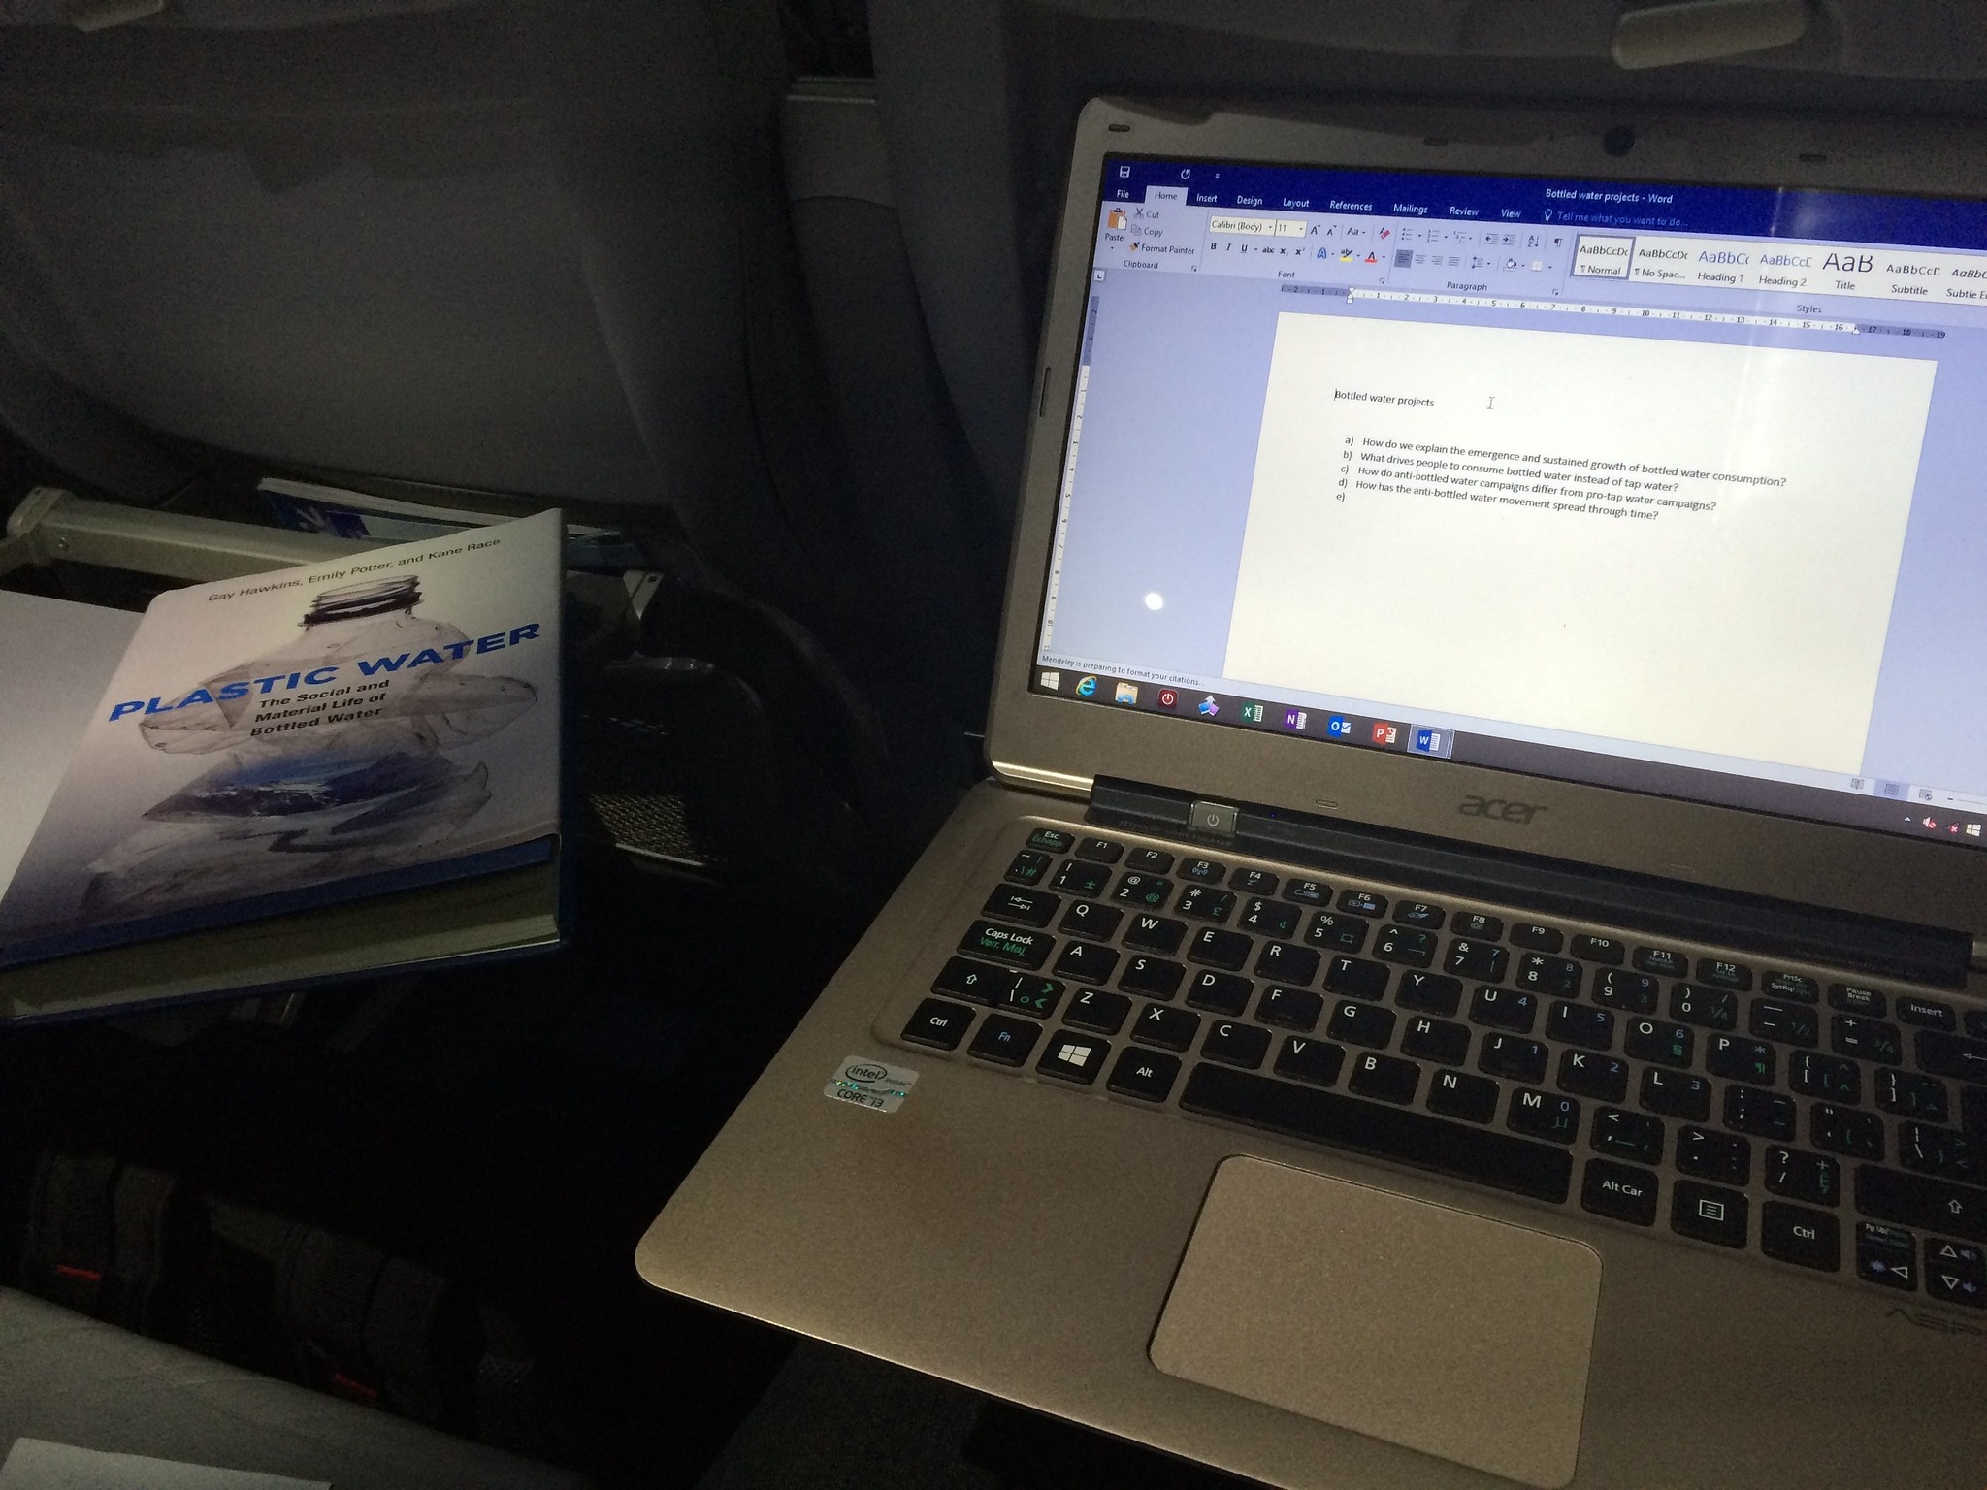

#AcWri on a plane by Raul Pacheco-Vega cc-by-nc-nd
006/365 by Jerry Cooke cc-by-nc-nd

Slide 5
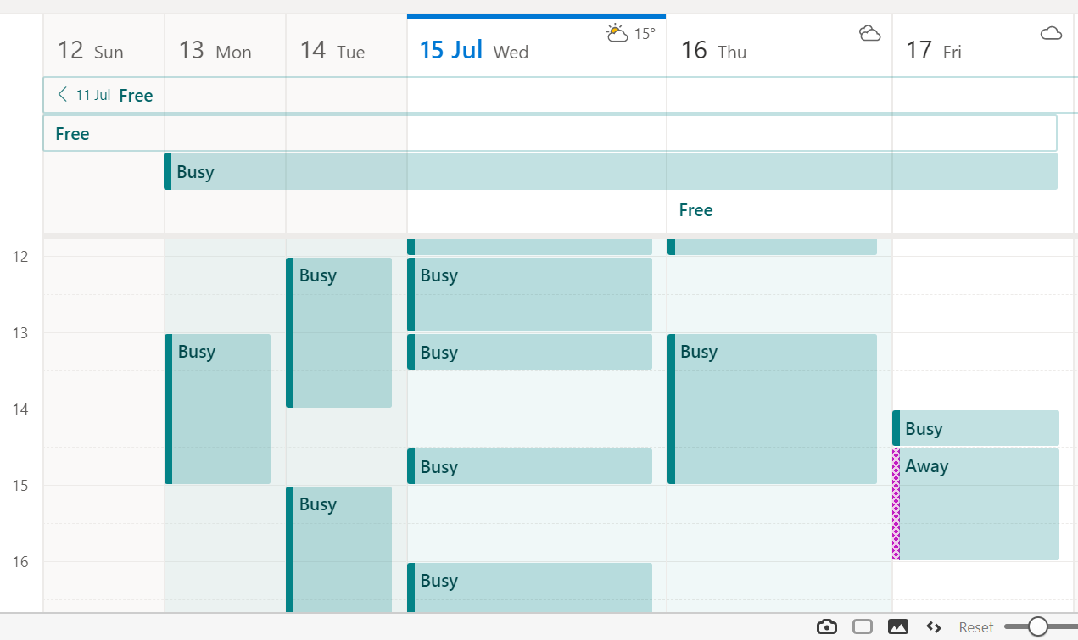
Hang on, there was something I was supposed to read before this meeting, where was it…
Meeting

Slide 6
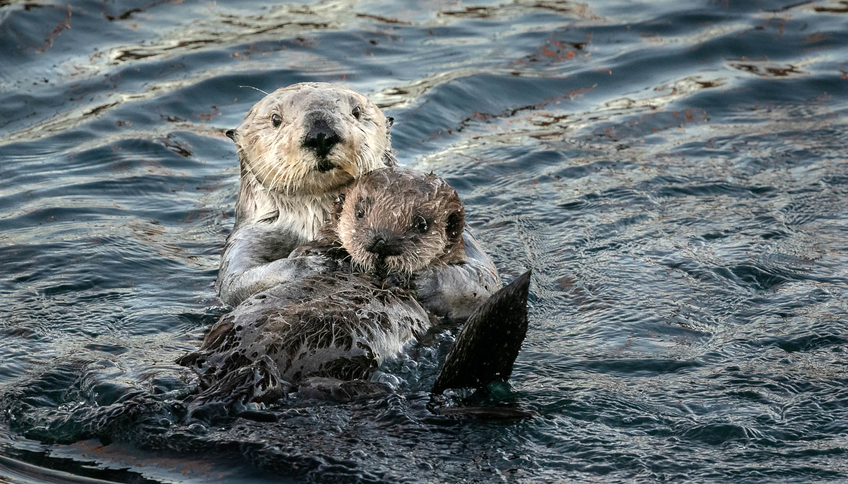
Relaxing with Mom by Don Henderson cc-by-nc

Slide 7
Step 1
Create your slide deck in the usual way

Slide 8
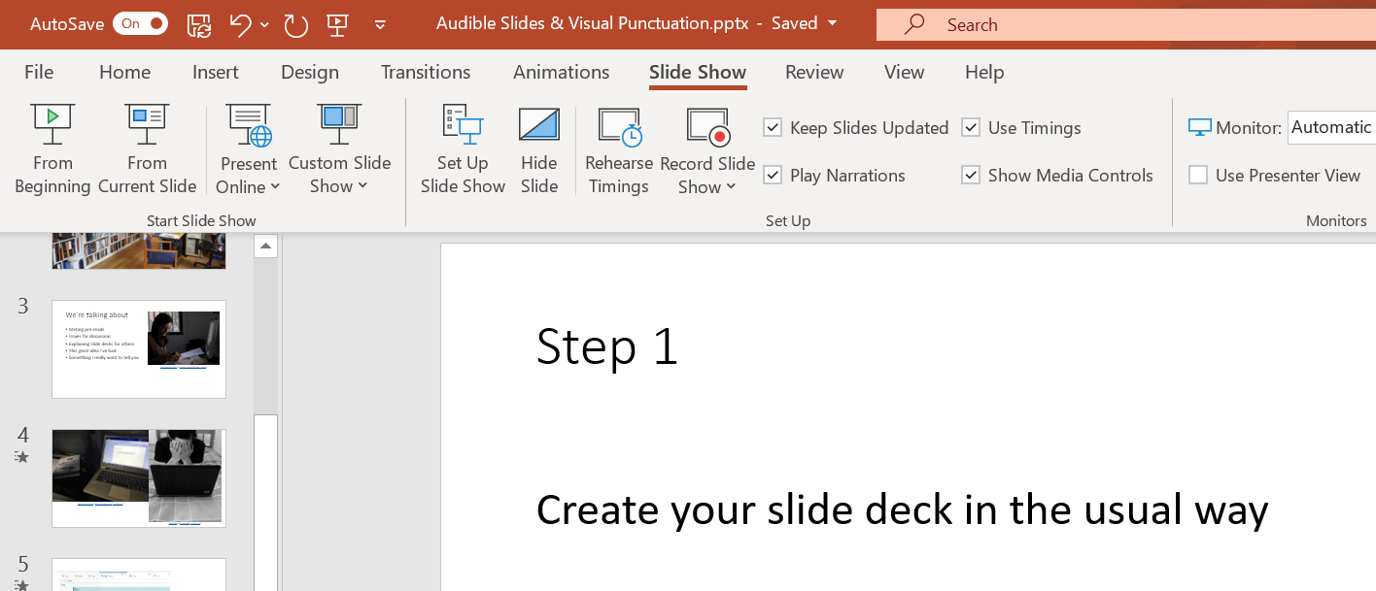
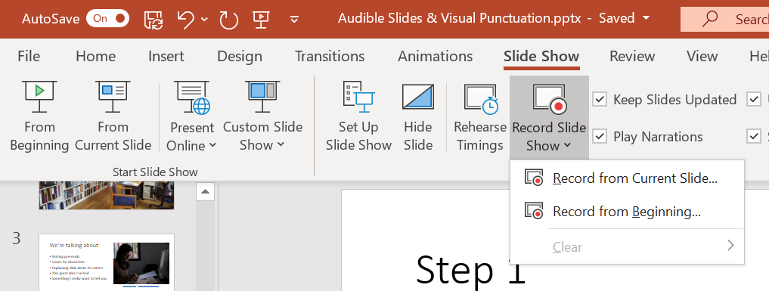

Slide 9
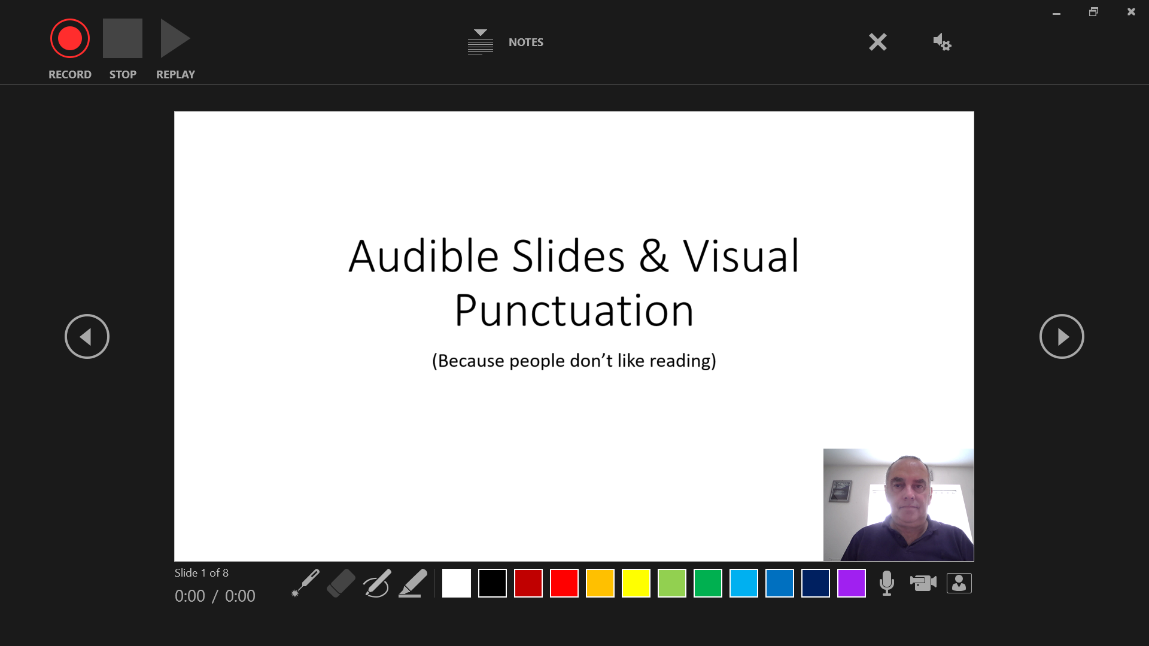

Slide 10
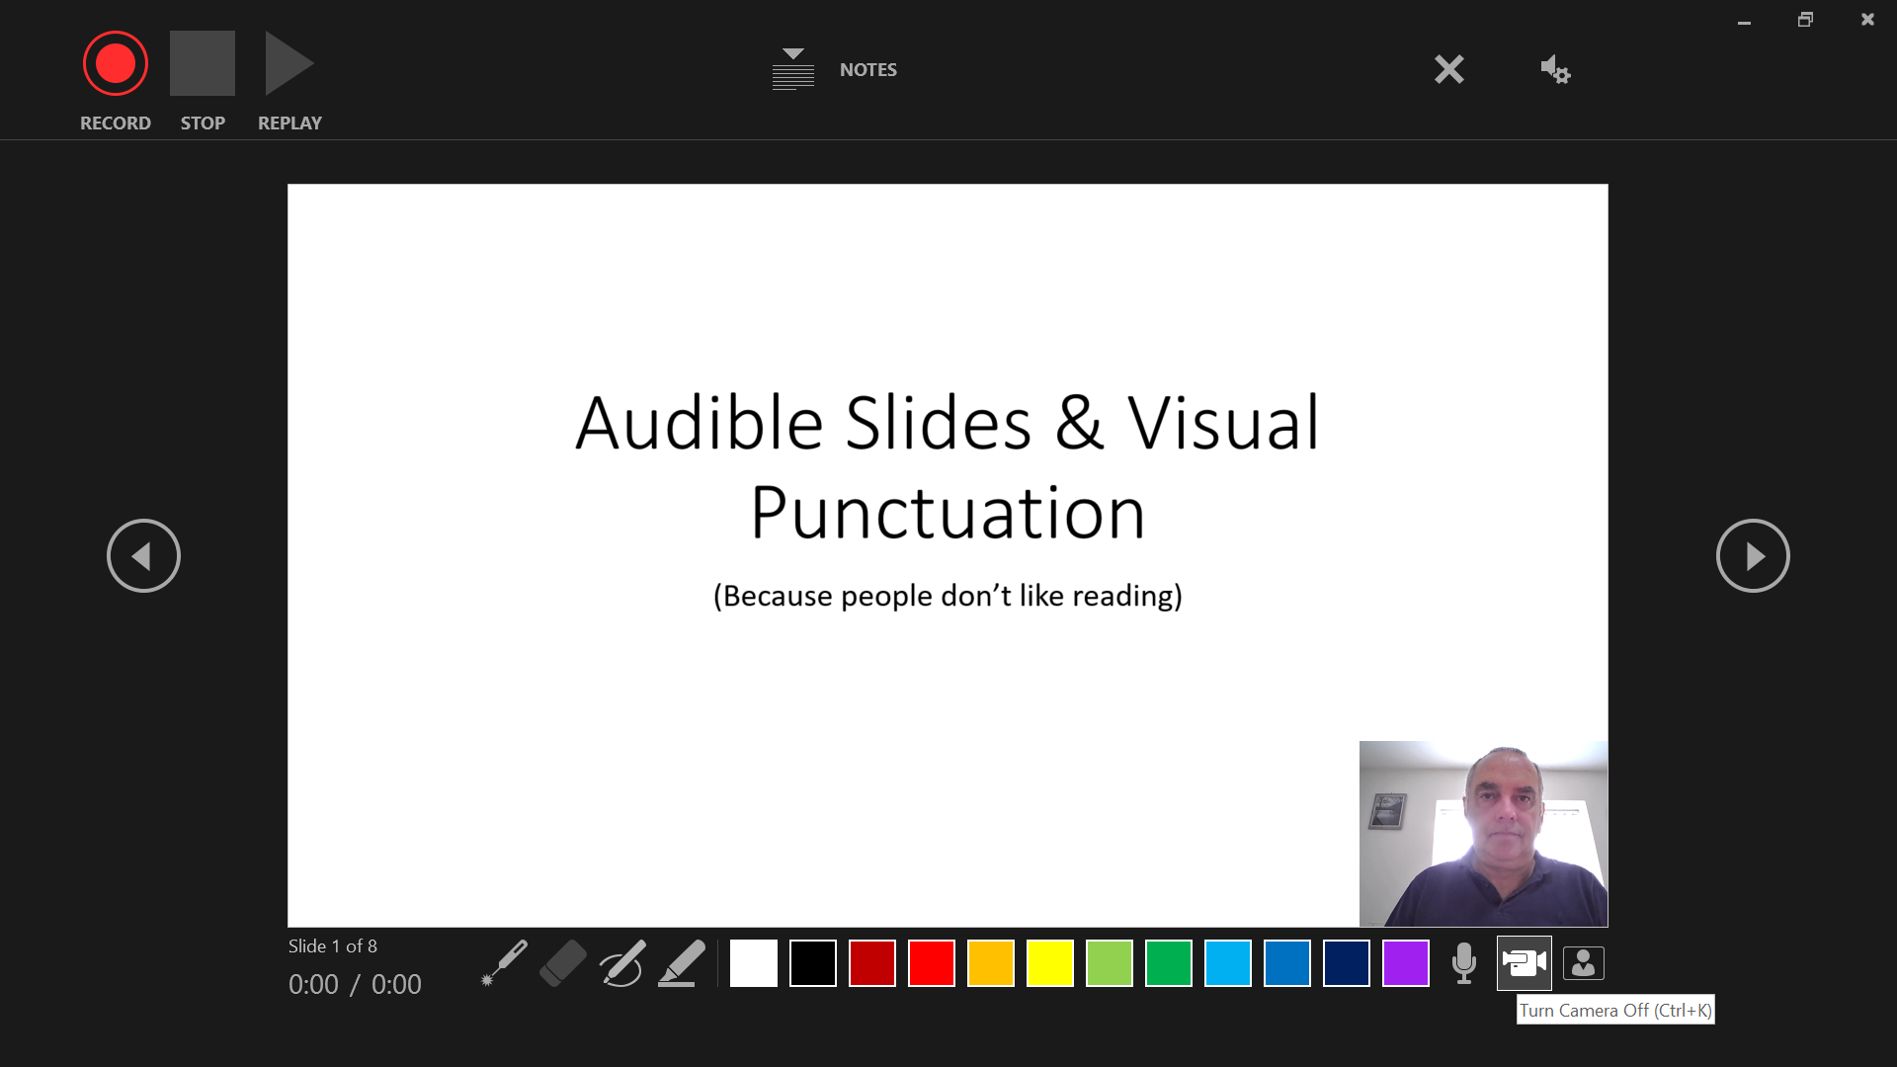

Slide 11
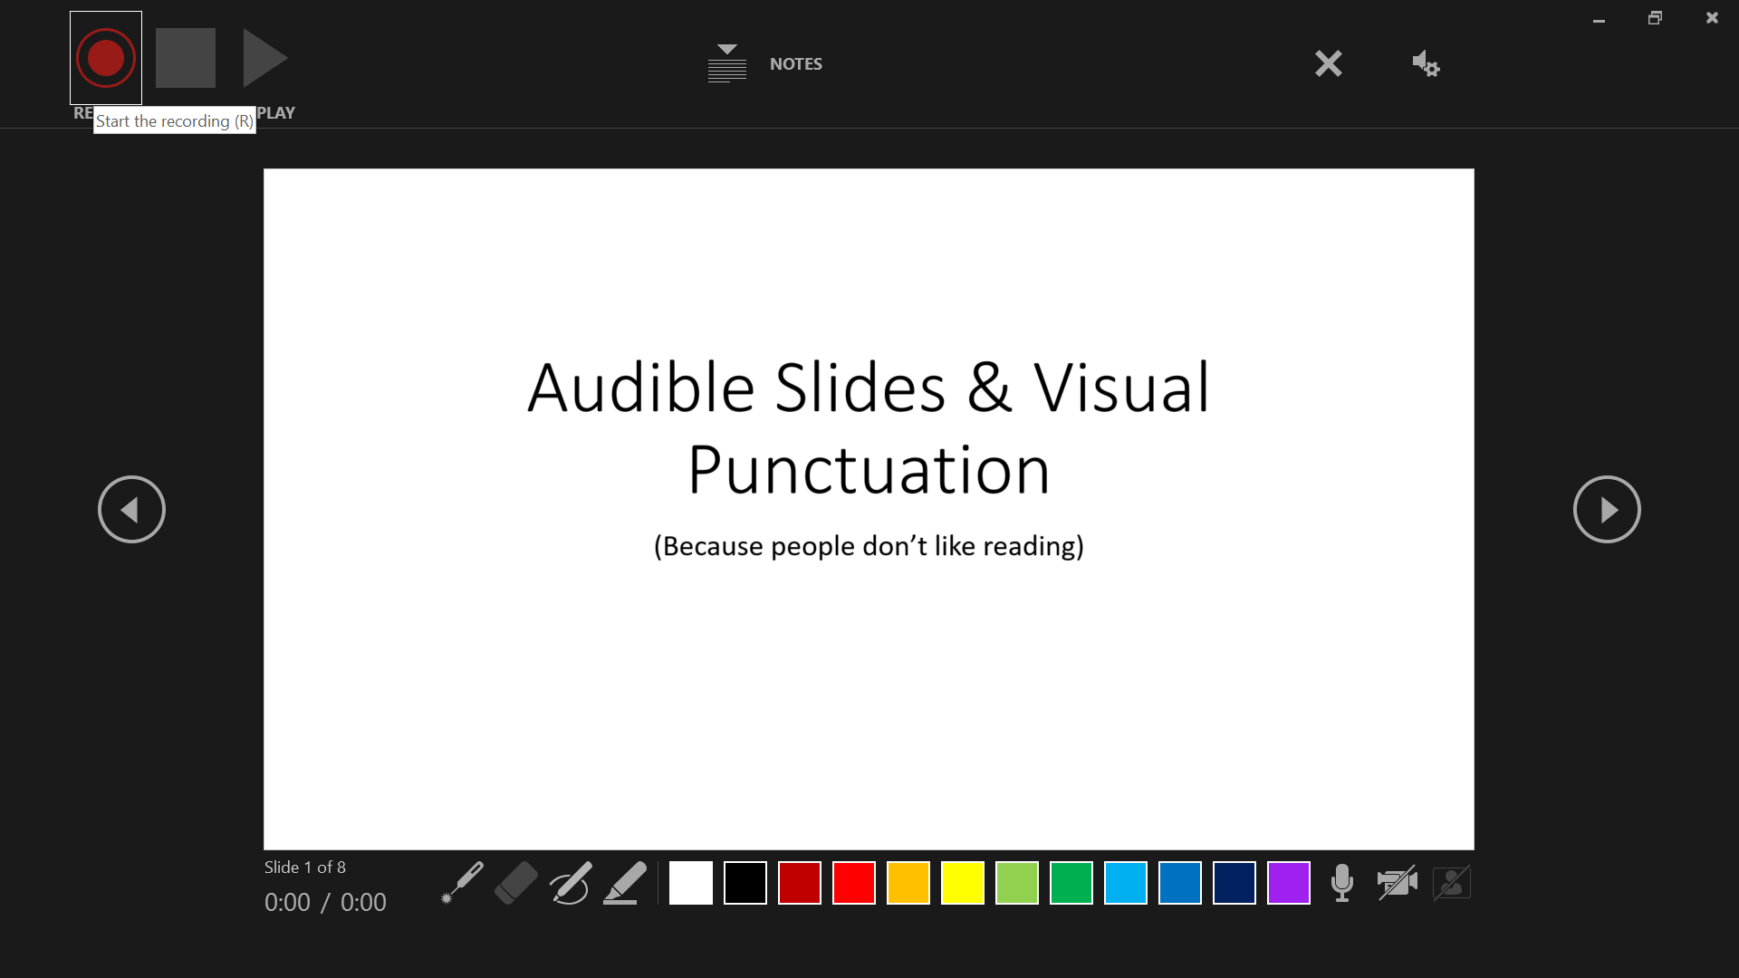

Slide 12
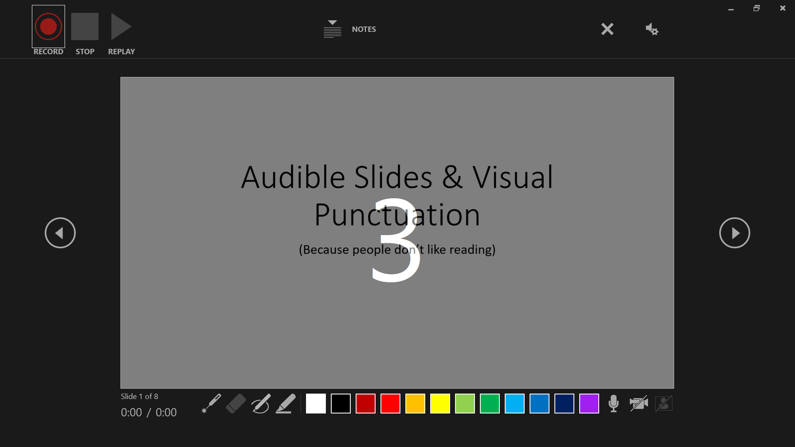

Slide 13
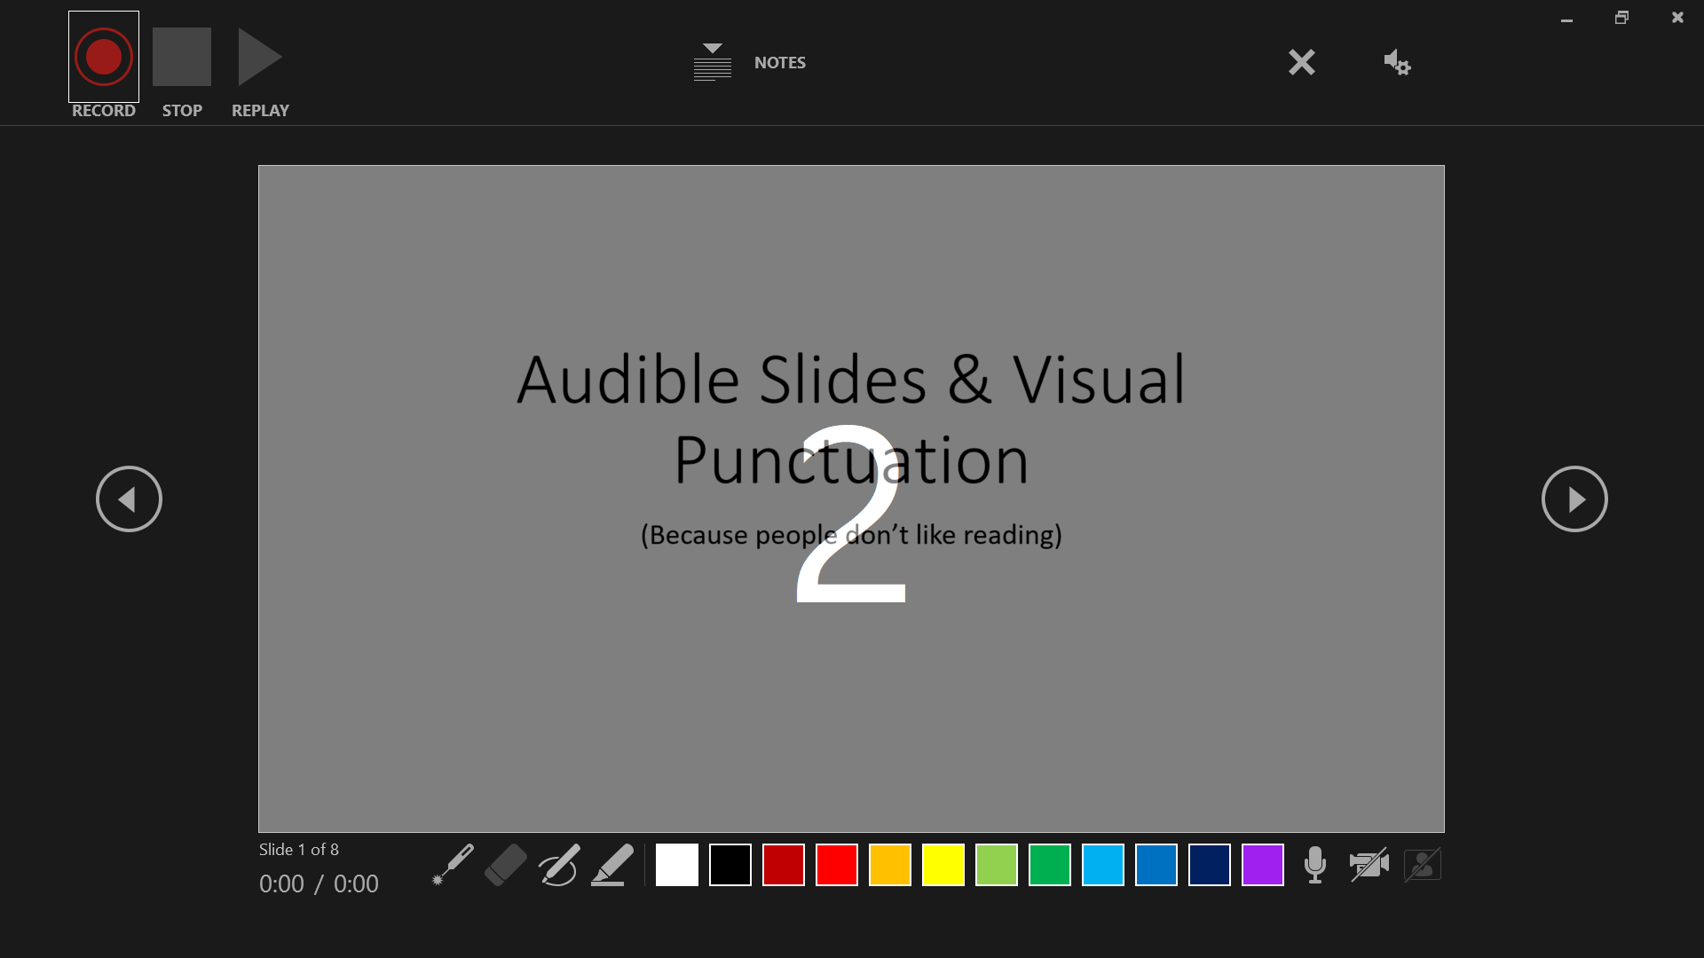

Slide 14


Slide 15
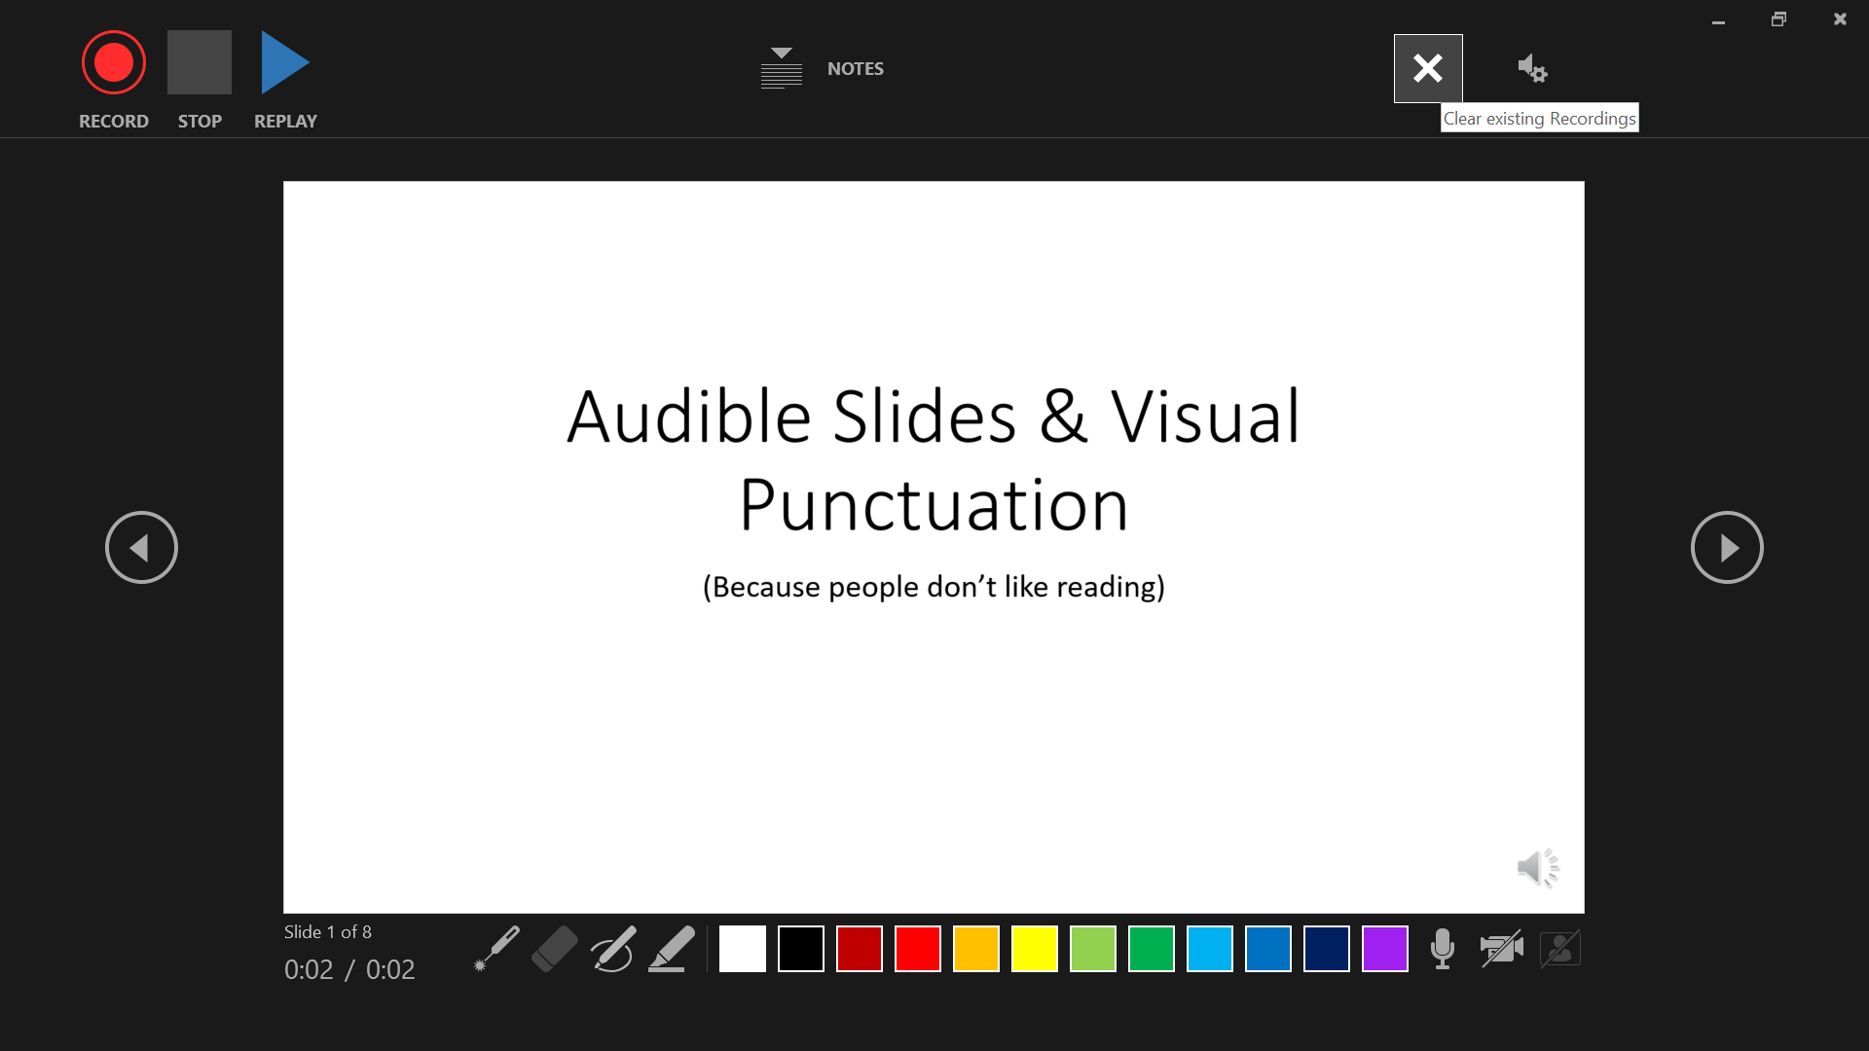

Slide 16
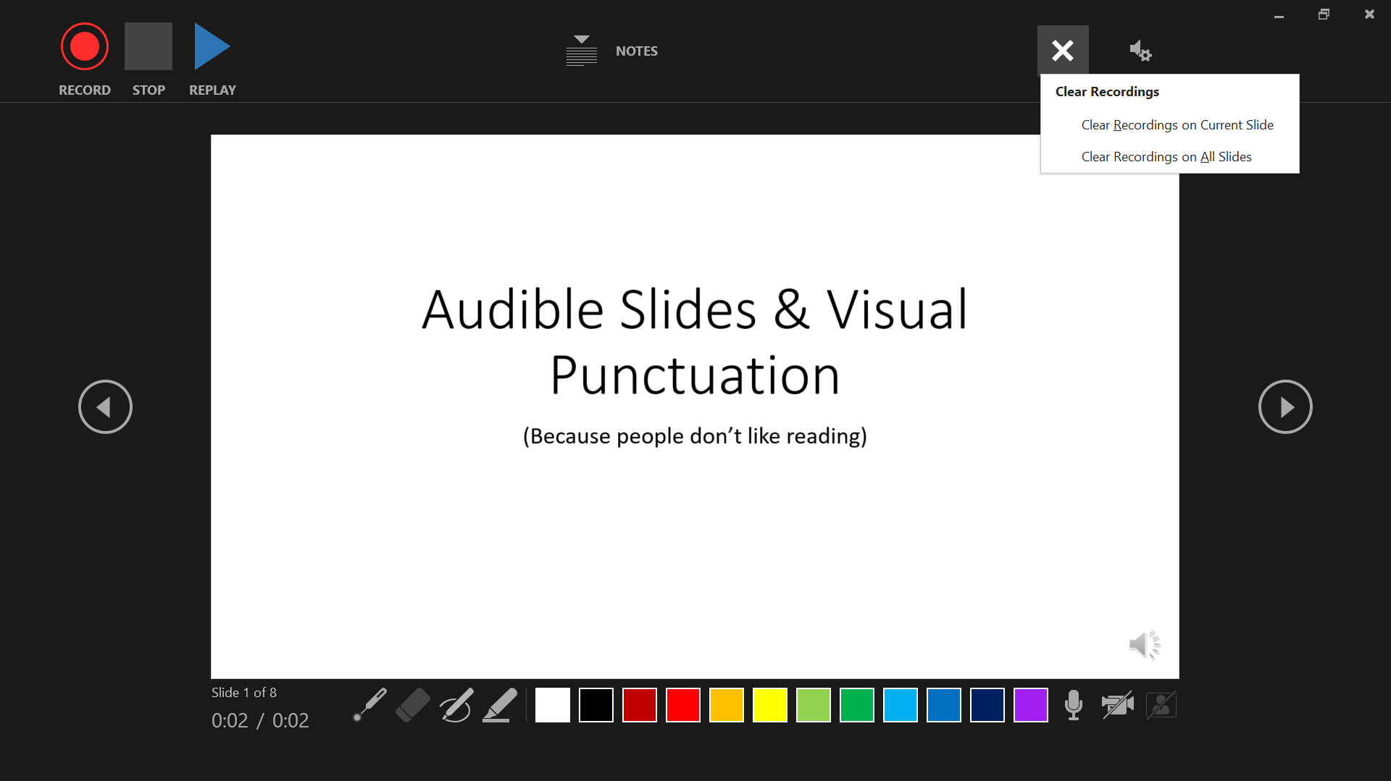

Slide 17
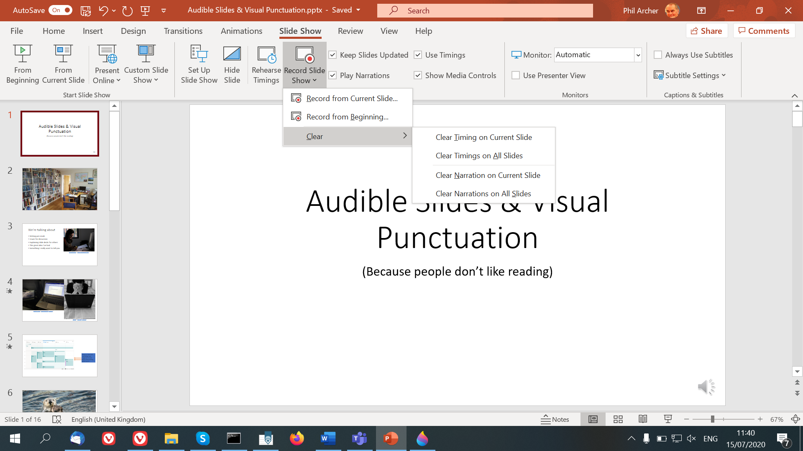

Slide 18
There are three discrete layers
The visual elements
The audio file
Timings of your clicks

Slide 19
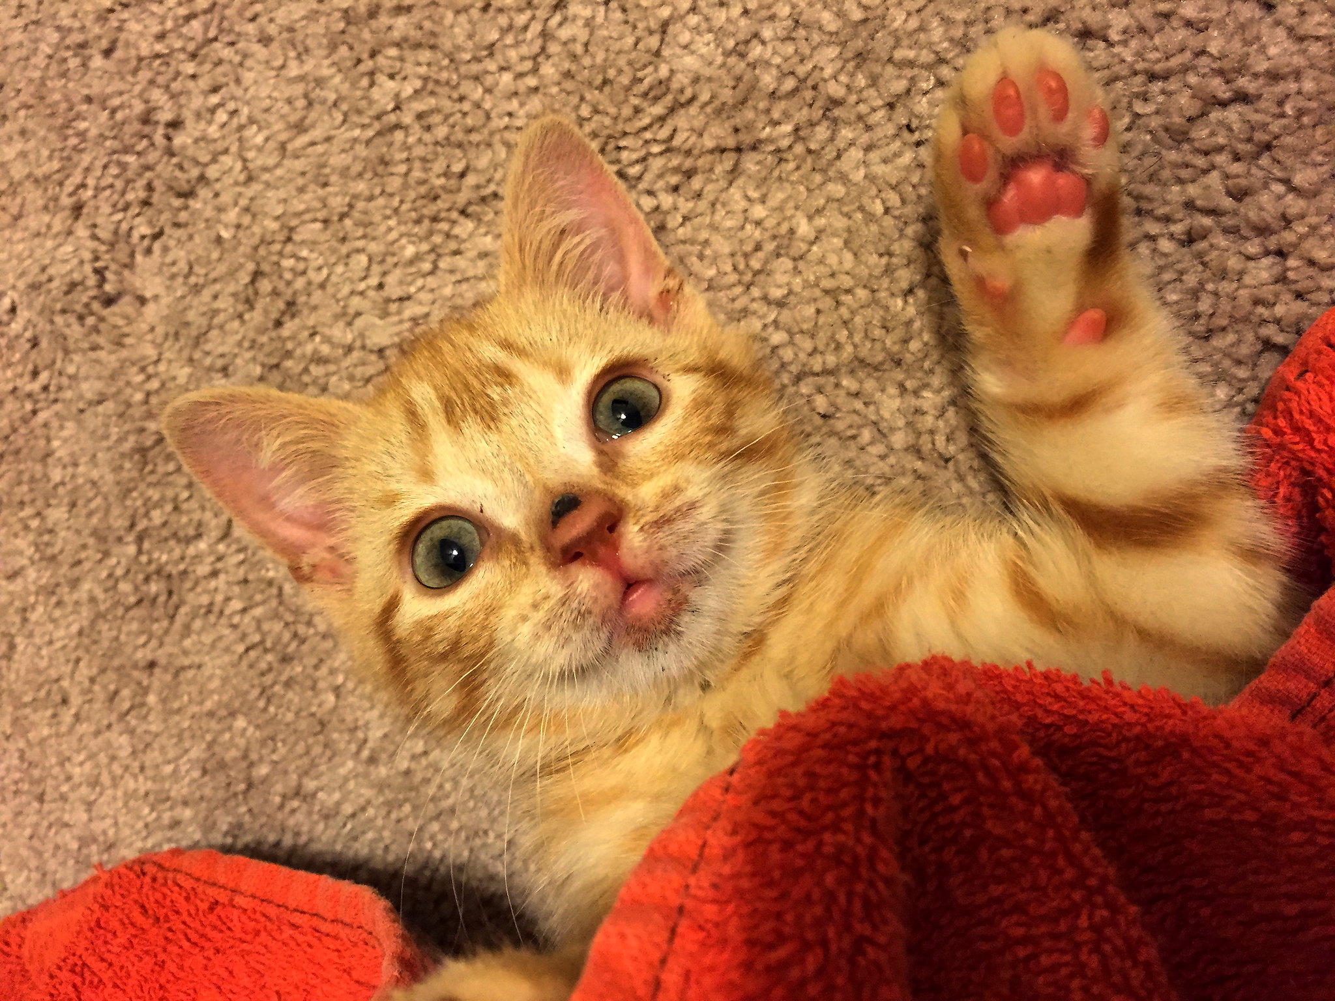
Gotcha! by Ceyhun Jay Isik cc-by-nc-nd

Slide 20
Gotcha! by Ceyhun Jay Isik cc-by-nc-nd
Every slide is separate
Audio does not play as you change slides

Slide 21
Gotcha! by Ceyhun Jay Isik cc-by-nc-nd
Beware when copying slides!

Slide 22
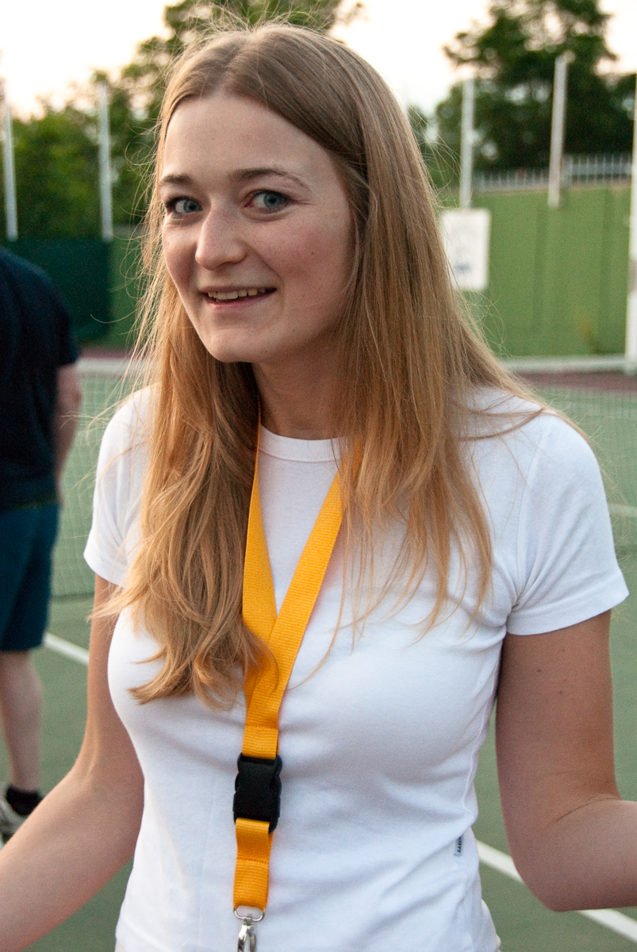
so what? by groucho cc-by-nc-nd

Slide 23
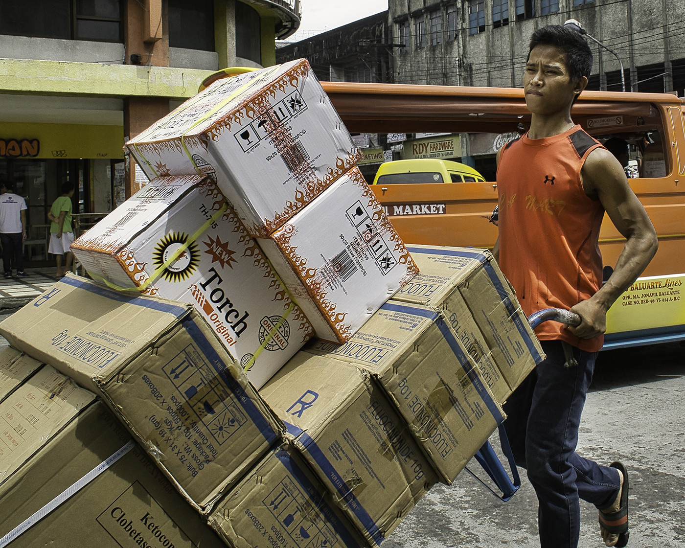
Heavy by Brian Evans cc-by-nd

Slide 24





email_large by doubleaf chen cc by-nc-nd

Slide 25
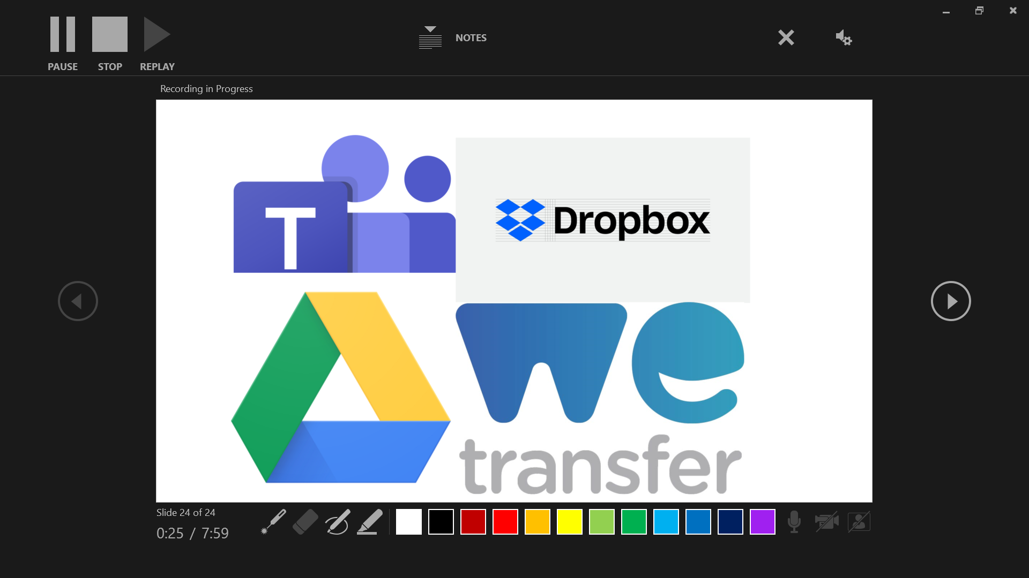

Slide 26
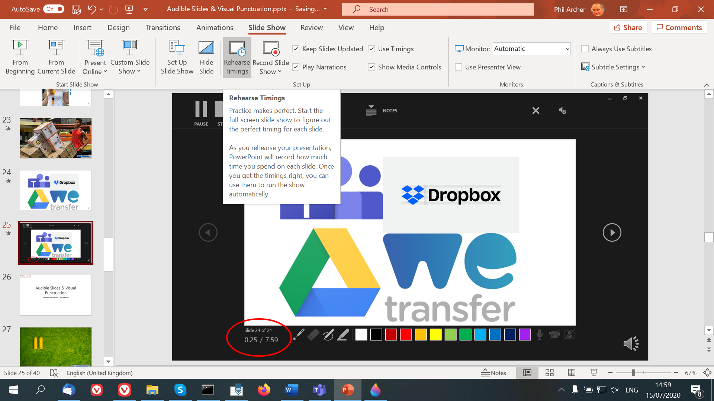

Slide 27
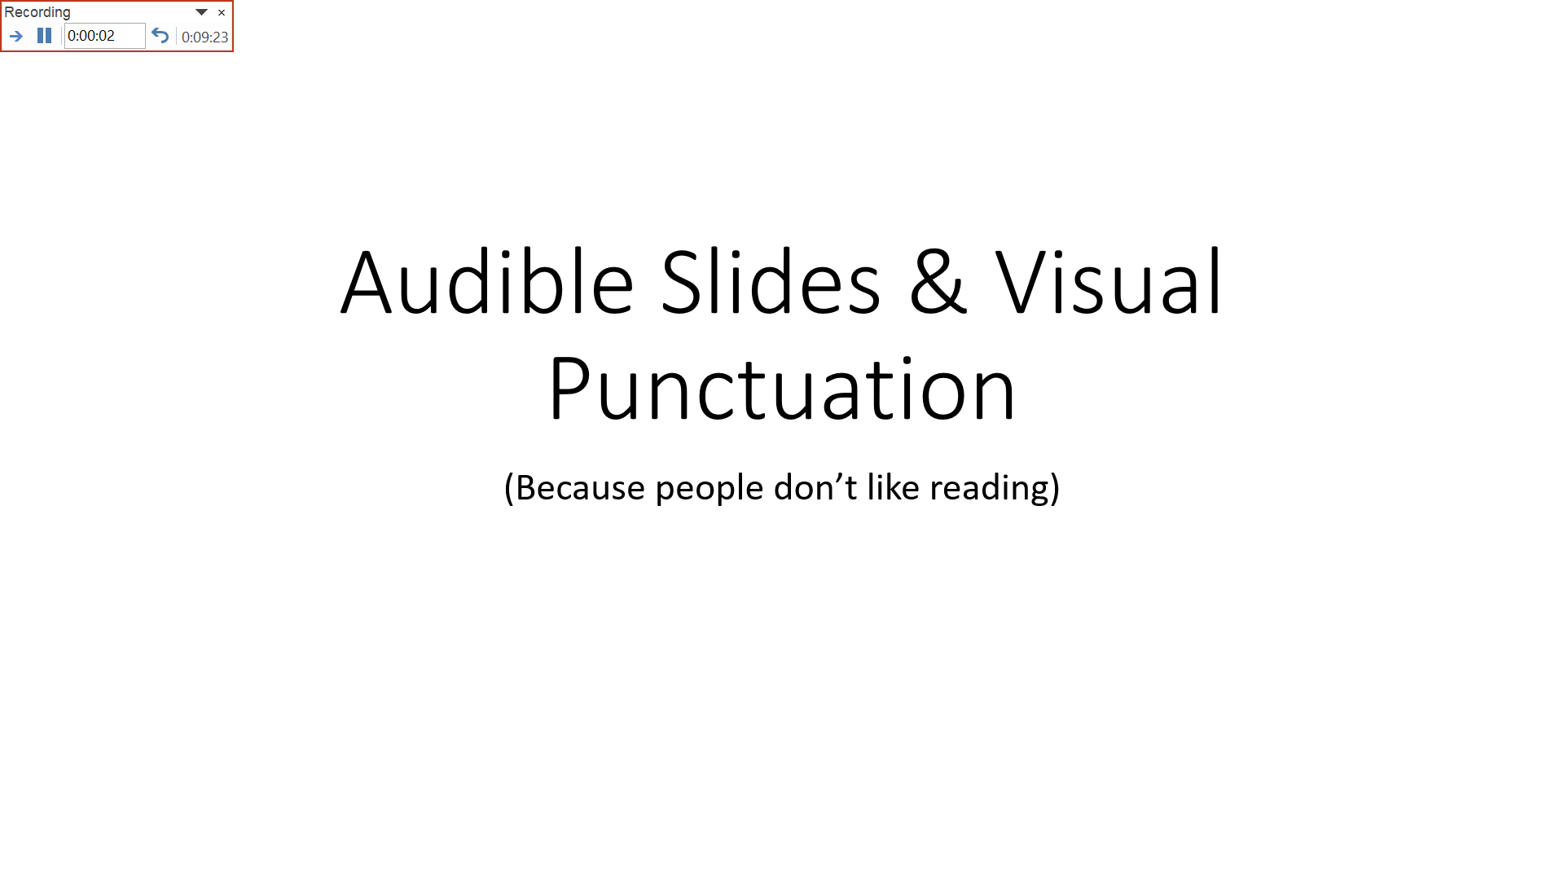
It will take your recipients this long to hear your presentation

Slide 28

Pause by Rafa Puerta cc-by-nc-nd
Notes:
Pause for questions

Slide 29
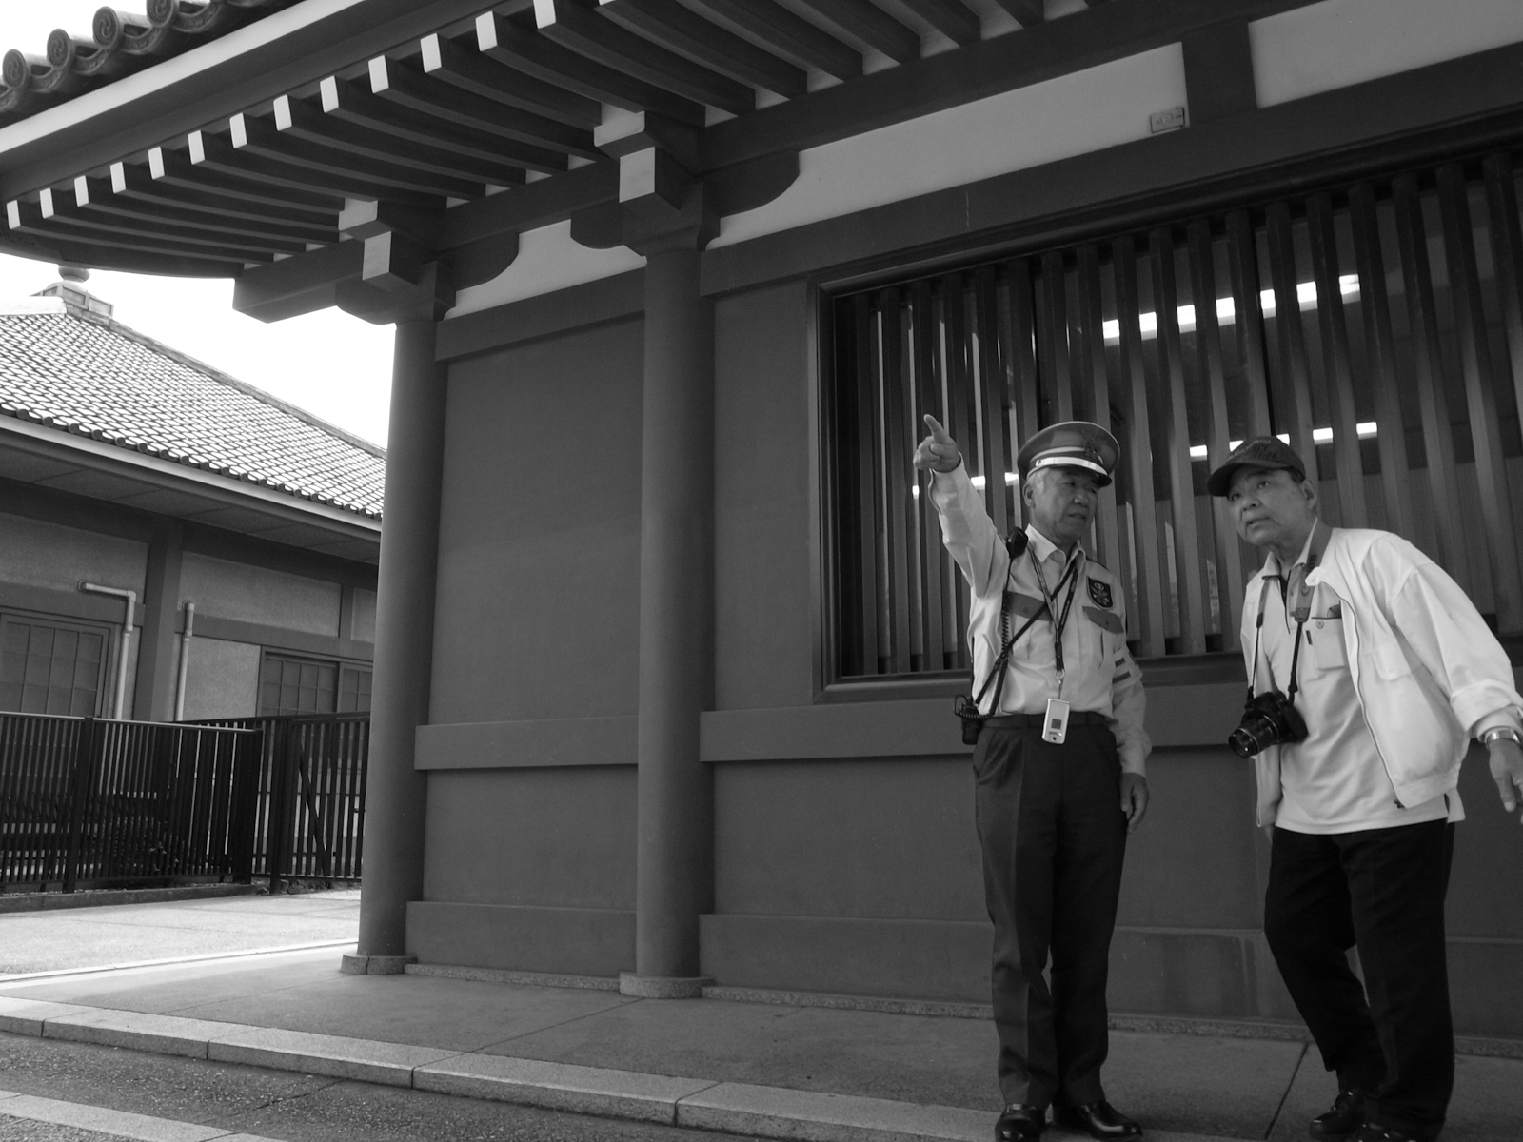
Directions by joohander cc-by-nc
Notes:
You need directions, a route from where you are to where you want to go.

Slide 30

IMG_1002 tomoko by Scott Moore cc-by-nc
Notes:
Please ask questions at any time – don’t wait, don’t be shy.
I may say “I’ll come to that” – there’s a lot to get through – but please feel free to ask any question at any time.
There are no stupid questions…

Slide 31
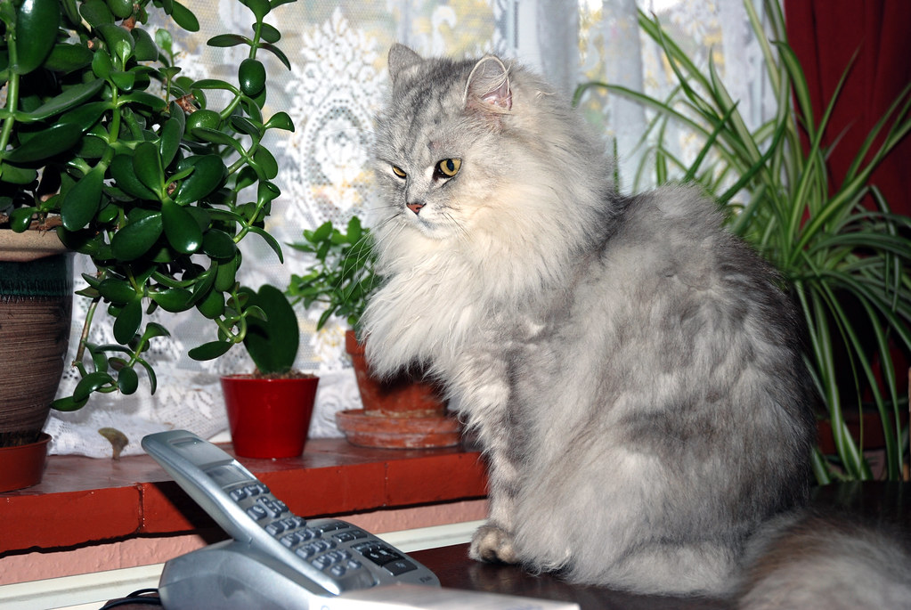
Waiting for the phone to ring by allen watkin cc-by-sa
Notes:
If you wait for the phone to ring with someone asking for DL, you’ll have a long wait.

Slide 32
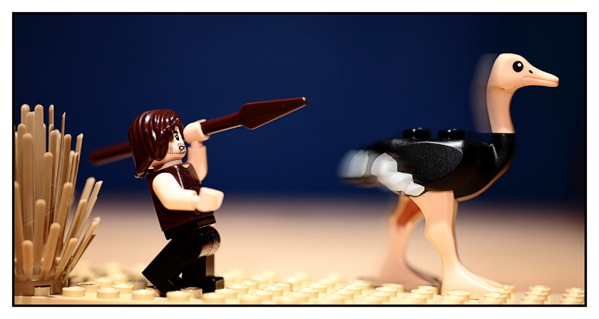
231/365 Fast Food by Dave cc-BY-NC-ND

Slide 33

Stranger #236 - Alum by Peter Grifoni cc-by-nc-nd
Notes:
You think printers and scanners are going to work with this? Only I’m a little sceptical…

Slide 34
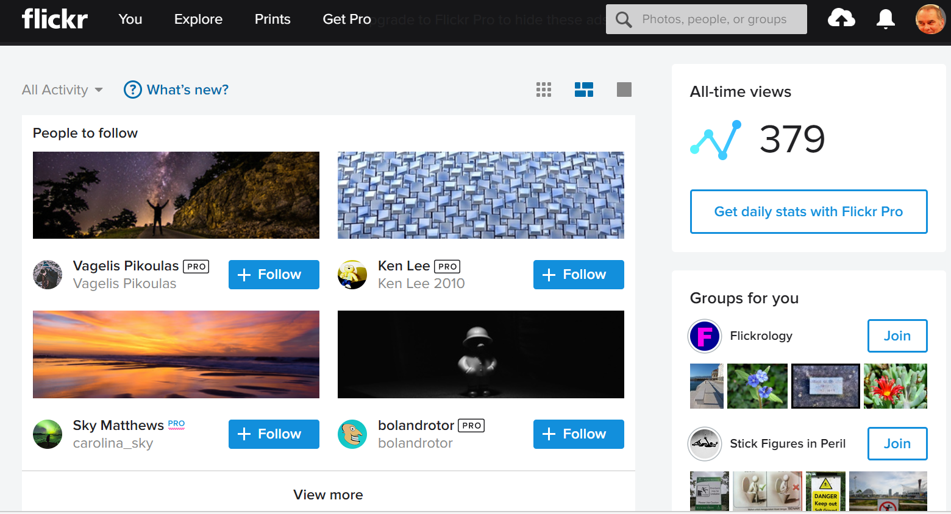

Slide 35
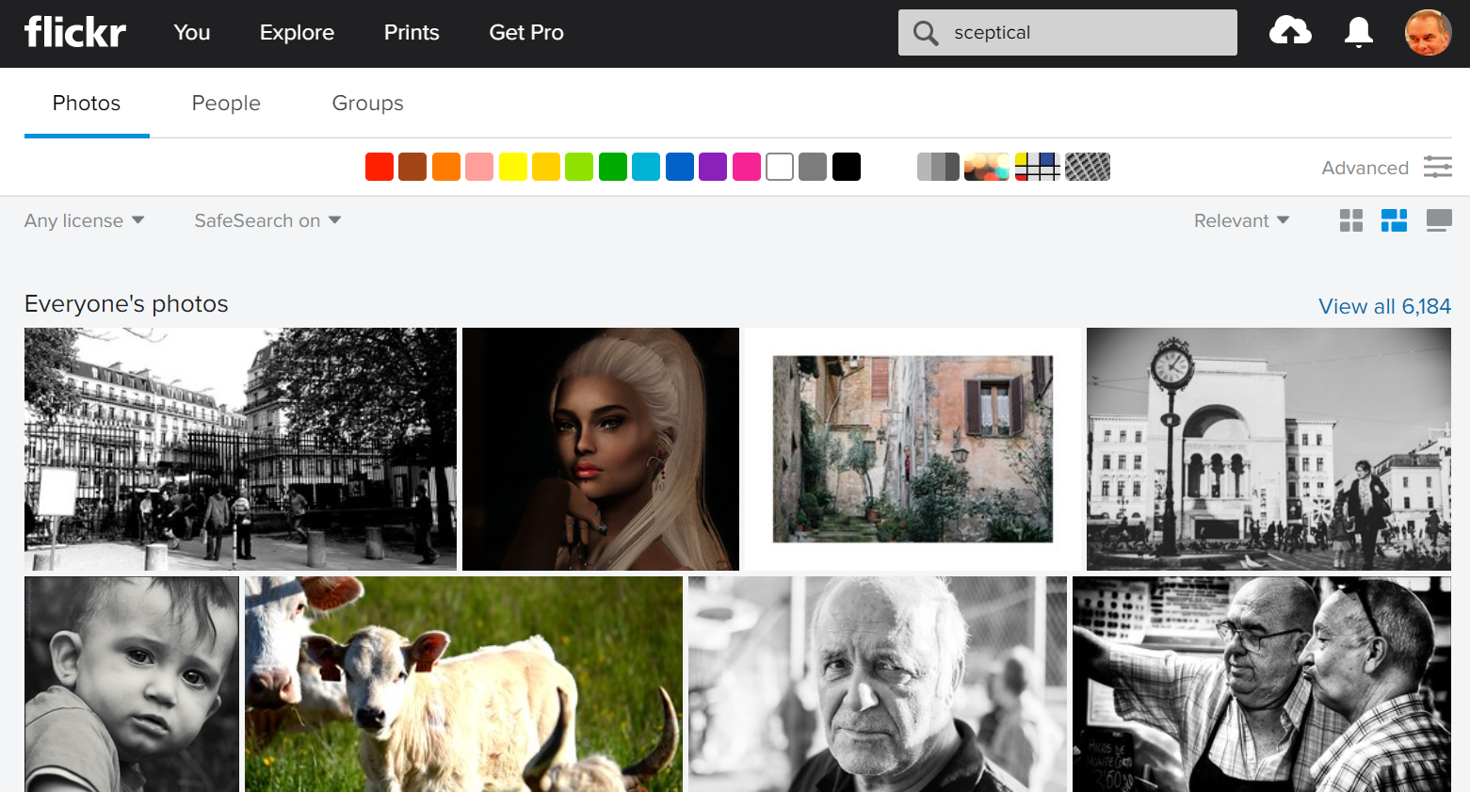

Slide 36
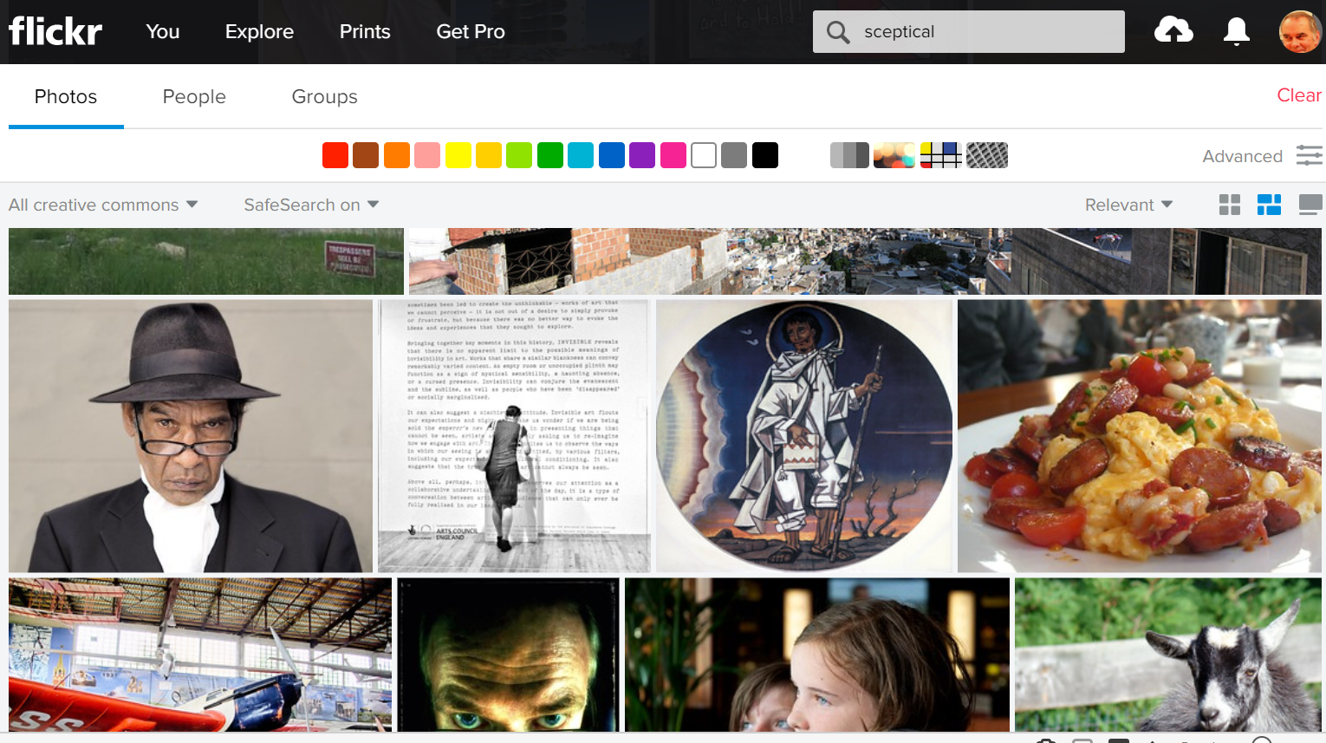

Slide 37
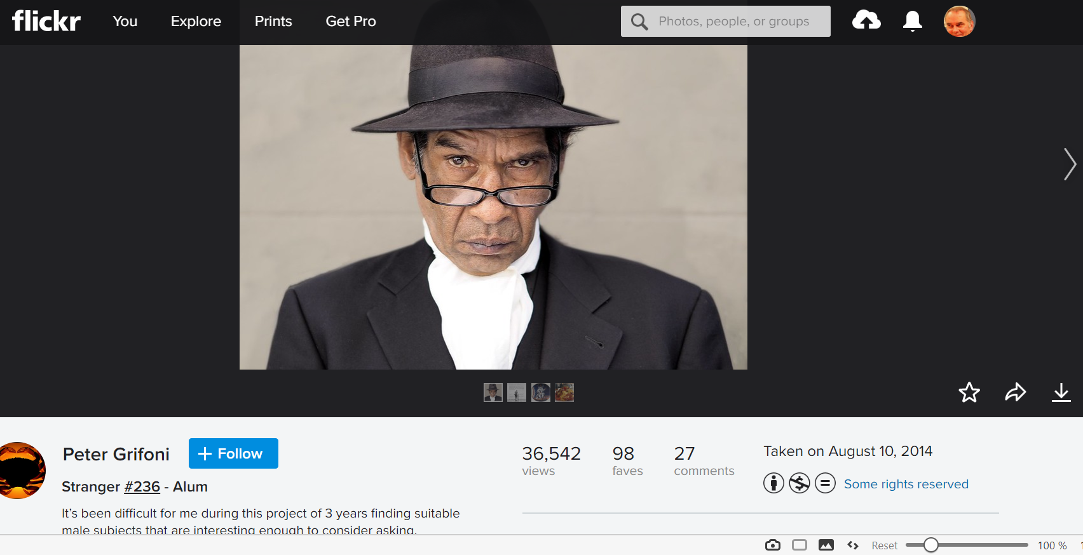

Slide 38
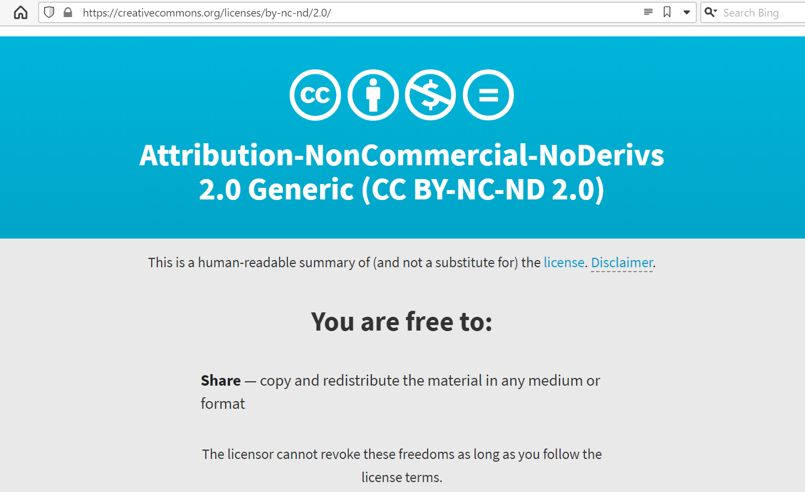

Slide 39
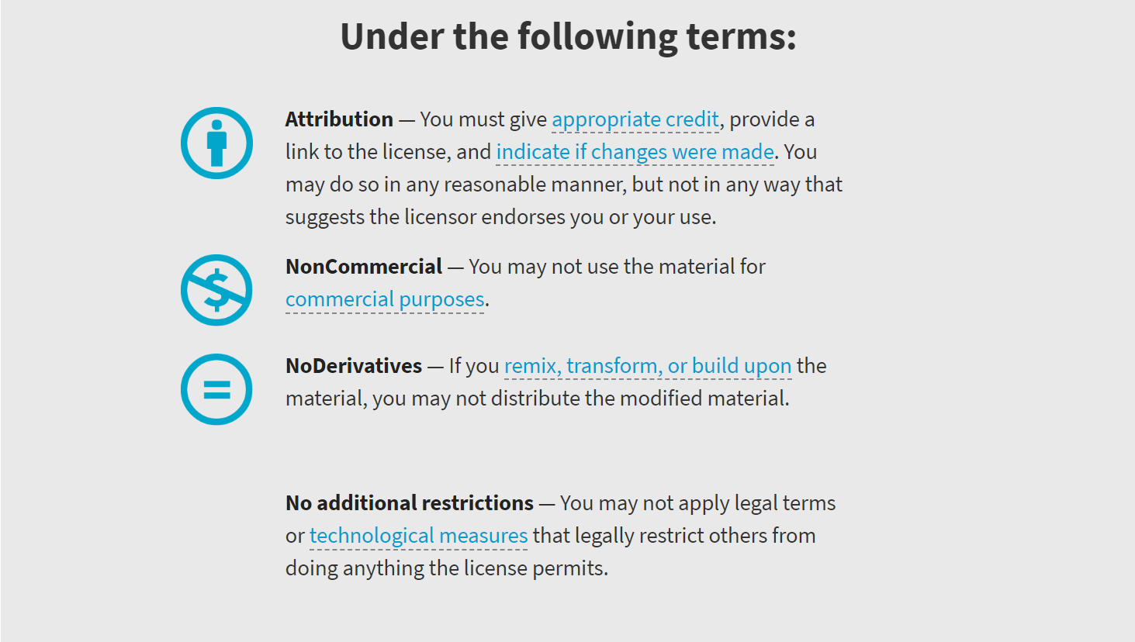

Slide 40
Stranger #236 - Alum by Peter Grifoni cc-by-nc-nd
Notes:
You think printers and scanners are going to work with this? Only I’m a little sceptical…

Slide 41
Narrated PowerPoint presentations
Are a good way to convey info to people in their own time
Make it easy on the recipient, saves them reading
Are likely to be a lot more lively than the written version
Can be livened up with images from Flickr – but take note of the Creative Commons licensing
Phil Archer
phil@philarcher.org
@philarcher1

